Slide 1
Histogram Processing
Histogram?
Histogram Equalization
Histogram Specification

Slide 2
Histogram
Histogram of an image gives global description of their appearance
It is a plot which shows how many times (frequency) each intensity value occurs in an image
The histogram of a digital image with gray levels from 0 to L-1 is a discrete function h(r_{k})=n_{k}, where:
--r_{k} is the kth gray level
--n_{k} is the # pixels in the image with that gray level
--k = 0, 1, 2, …, L-1

Slide 3
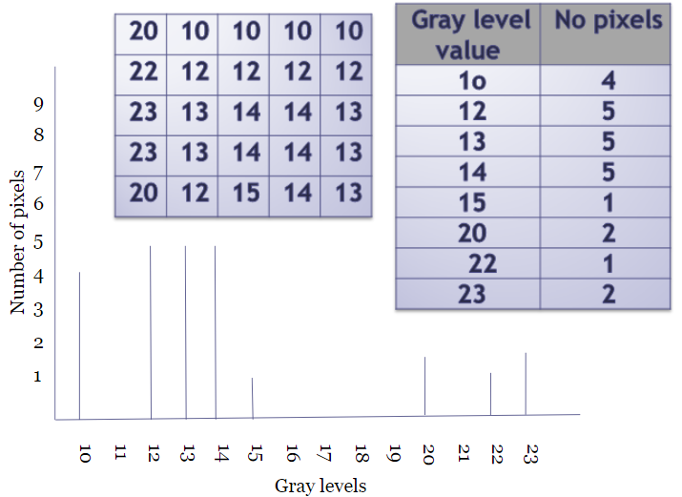

Slide 4
Normalized histogram:
p(r_{k})=n_{k}/MN
--p(r_{k})-> Prob. Of occurrence of intensity level r_{k} in image
Plot of p(r_{k}) Vs. r_{k} is referred to as a Histogram

Slide 5
Histograms

Slide 6
Histogram Processing
Shape of histogram provides useful information for contrast enhancement
Types of Processing
1) Histogram Equalization
2) Histogram Matching

Slide 7
Histogram Equalization: It spreads the histogram of the input image so that the intensity levels of the equalized image span a wider range of intensity scale

Slide 8
Contd..(fig 3.20)

Slide 9
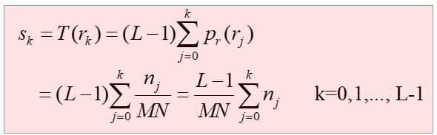
Method:

Slide 10
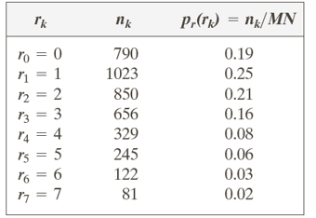
Example:
Suppose that a 3-bit image (L=8) of size 64 × 64 pixels (MN = 4096) has the intensity distribution shown in following table. Perform histogram equalization

Slide 11
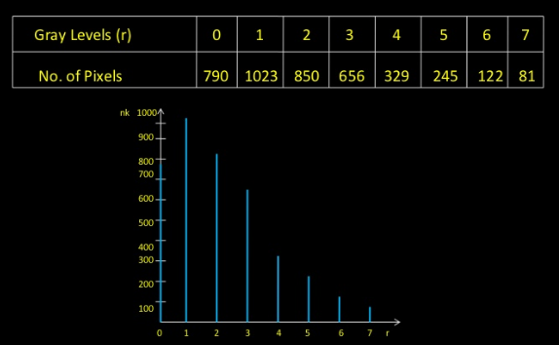

Slide 12
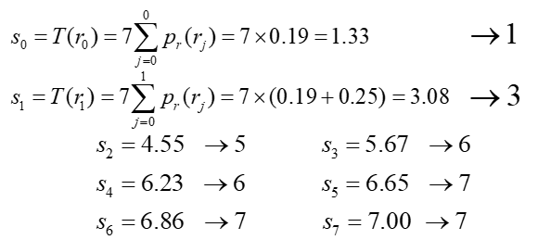

Slide 13
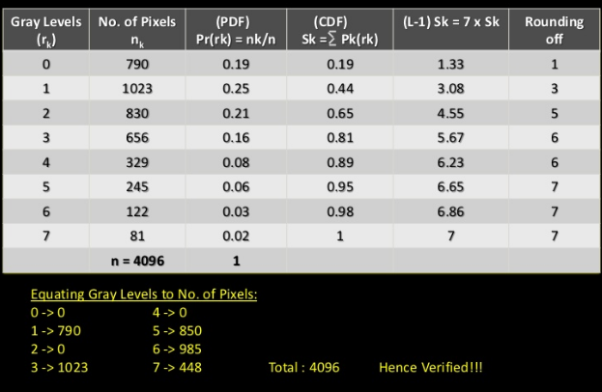

Slide 14
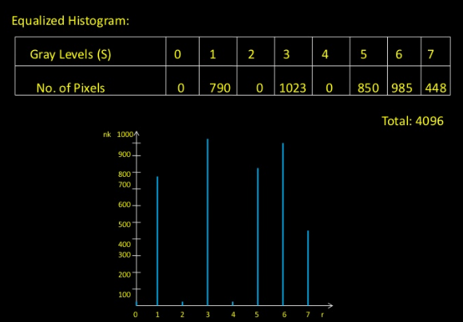

Slide 16
Histogram Specification

Slide 17
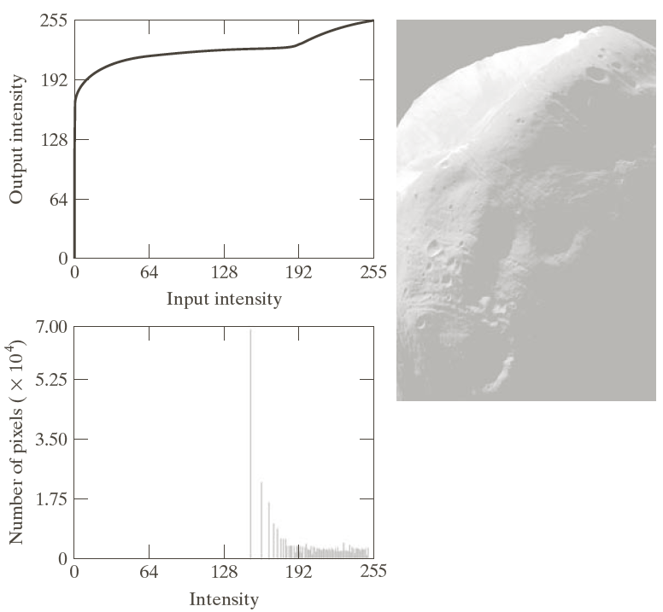

Slide 19
Histogram specification(Ex)

Slide 20
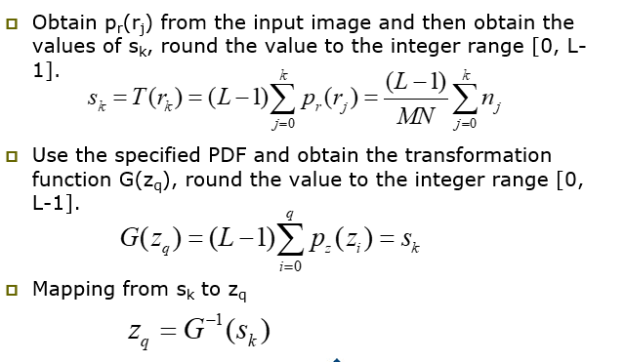
Procedure

Slide 21
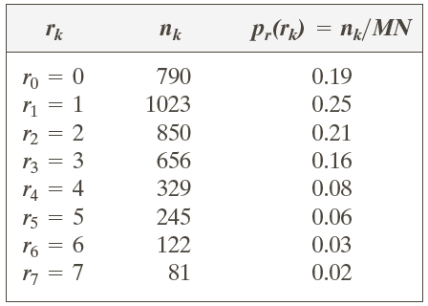
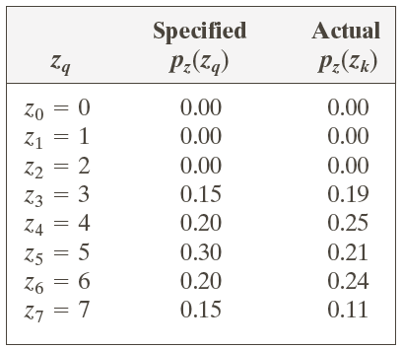
Example: Histogram Matching
Suppose that a 3-bit image (L=8) of size 64 × 64 pixels (MN = 4096) has the intensity distribution shown in the following table (on the left). Get the histogram transformation function and make the output image with the specified histogram, listed in the table on the right.

Slide 22
Example: Histogram Matching
Obtain the scaled histogram-equalized values,
Compute all the values of the transformation function G,

Slide 23
Example: Histogram Matching
Obtain the scaled histogram-equalized values,
Compute all the values of the transformation function G,
s₀
s₁
s₂
s₃
s₄
s₅
s₆
s₇

Slide 24
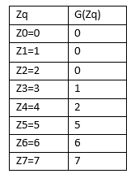
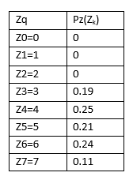

Slide 25
Example: Histogram Matching

Slide 26
Example: Histogram Matching

